Slide 1



DEPARTMENT OF ELECTRONICS AND COMMUNICATION ENGINEERING 18ECP103L – MINOR PROJECT 2 TRIPLE BAND MIMO ANTENNA FOR 5G MOBILE APLLICATION BATCH NO:35
PRESENTED BY:
S.PADMAVATHI [927621BEC141] GUIDE:
K.NAVEENA [927621BEC136] Mr.M.DHAMODHARAN
G.PAVITHRA [927621BEC143] Professor/ECE
G.PAVIPRAVEENA [927621BEC142]

Slide 2
CONTENTS
Antenna
Objective
Abstract
Software used
Result and Conclusion
References

Slide 3
ANTENNA
In order to address the demand of higher data rates and greater channel capacity, multiple input multiple output (MIMO) antenna technology will be applied to fifth-generation (5G) communication applications.
In MIMO solutions, a large number of antennas will be placed in the limited space of the mobile terminal. Increasing spectrum efficiency can effectively improve communication capabilities.
However, due to the limited spectrum resources, it is necessary to increase the operating frequency of the antenna

Slide 4
OBJECTIVES
The main objective of this project is to understand the working and the design of the antenna.
Specific Objective:
To design the antenna according to designed specifications.
To be acquainted with some of the characteristics of parasitic antenna element modelling and operations.
To know the antenna radiation pattern.
Test antenna and verify it performs as expected.

Slide 5
ABSTRACT
In this paper, a multiple input multiple output (MIMO) 4-antenna array is proposed and designed for 5G mobile terminal communication.
The antenna array is composed of four triple-band antennas placed along the long edges on both sides of the terminal.
It adopts a bent structure to achieve miniaturization and can cover the ISM (Industry Science Medicine) frequency band of 2370-to-2450MHz, and the 5G operating frequency bands of 3510-to-3610MHz and 4830-to-5080MHz allocated by the Ministry of Industry and Information Technology.

Slide 6

SOFTWARE USED
Ansys HFSS.
HFSS - High Frequency Structure Simulator.
HFSS is the one of the several commercial
tools used for antenna design,
transmission lines and packaging.

Slide 7
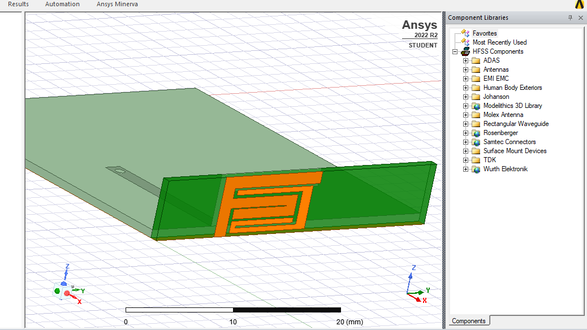
ANTENNA DESIGNED

Slide 8
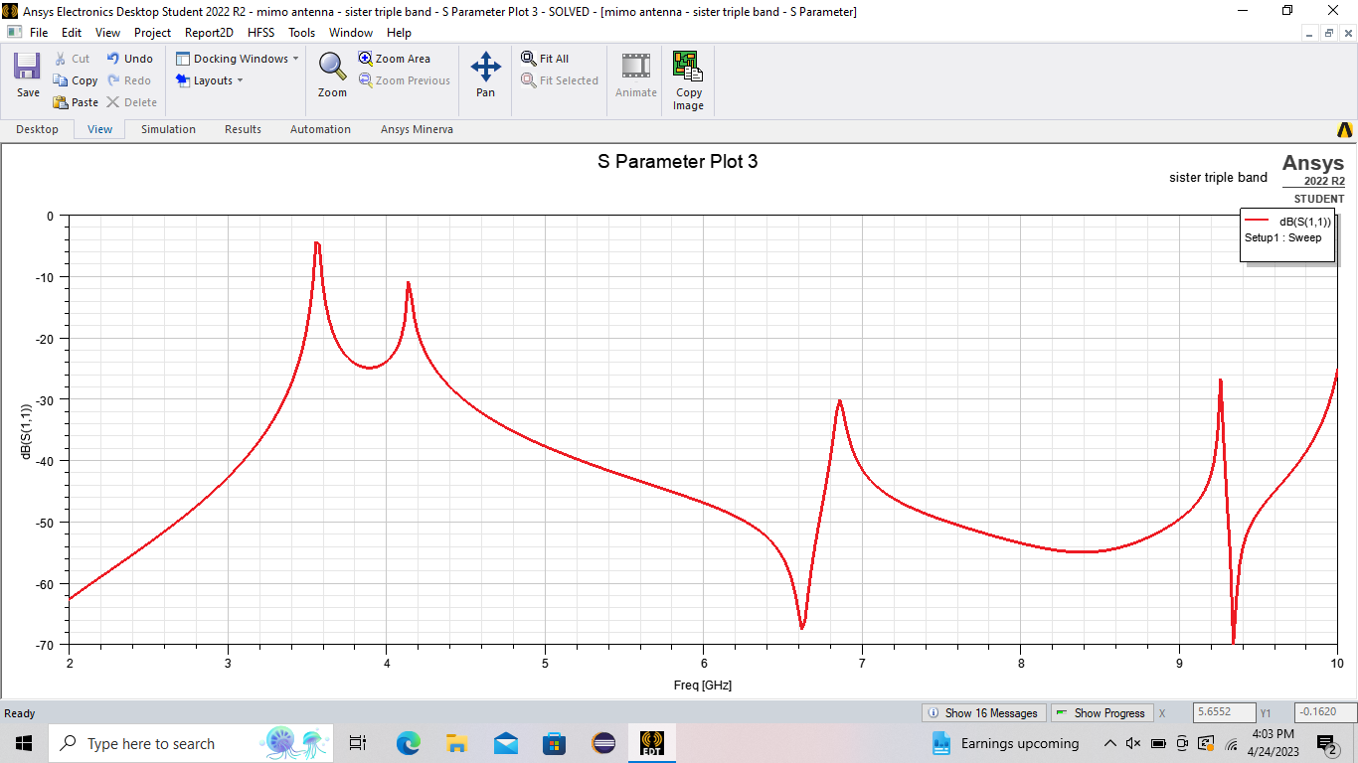
RESULT

Slide 9
S PARAMETER
It is a parameter which indicates the amount of power that is “lost” to the load and does not return as a reflection.
A graph of s11 of an antenna vs frequency is called its return loss curve.
For optimum working such a graph must show a dip at the operating frequency and have a minimum dB value at this frequency.

Slide 10
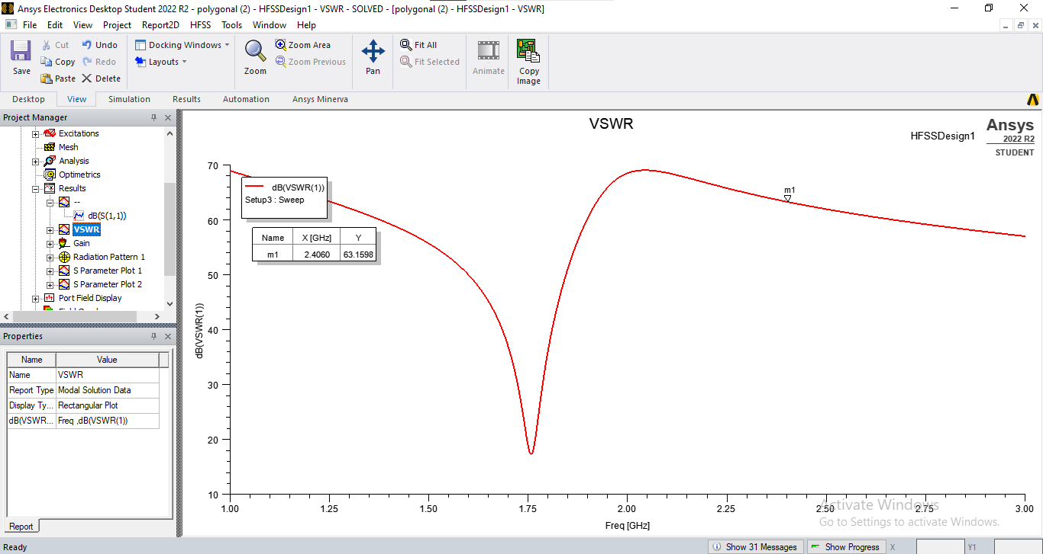
VSWR

Slide 11
VSWR
The VSWR is a parameter that describes how RF power is absorbed by a load in an antenna system.
The VSWR is used to check the working status of the antenna feeder systems. The antenna feeder subsystem includes antenna, feeder line, RF frequency connector, arrester and other accessory equipment.
The maximum transfer of power to the load occurs only when the load impedance perfectly matches the signal source impedance. If not, the signal will be to some degree reflected back to the signal source.

Slide 12
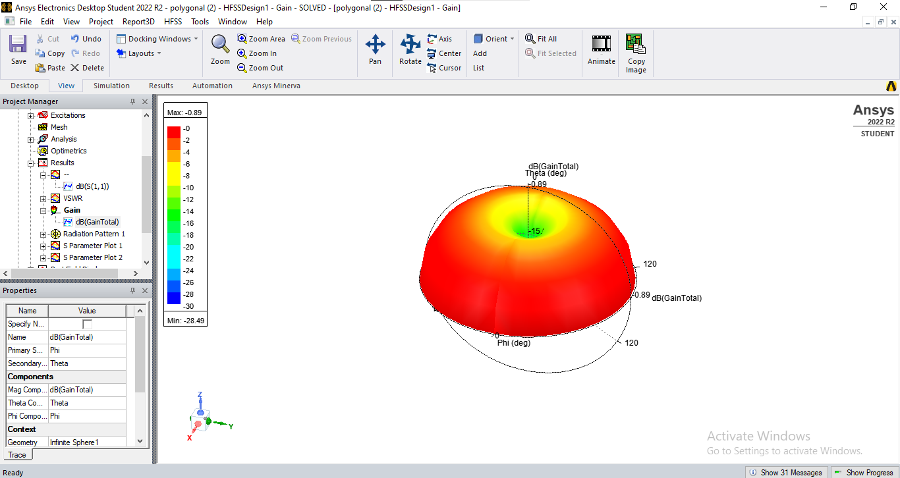
GAIN

Slide 13
GAIN
Gain is a measure of the ability of the antenna to direct the input power into radiation in a particular direction and is measured at the peak radiation intensity.
Gain is achieved by directing the radiation away from other parts of the radiation sphere. In general, gain is defined as the gain-biased pattern of the antenna.

Slide 14
CONCLUSION
We present the design process followed by simulation and measurement verifications.
A novel MIMO antenna suitable for 5G frequency band is proposed in this paper.
By using an appropriate feeding structure and feeding method, three resonant modes are excited.
The prototype antenna shows good bandwidth performance and radiation efficiency, making it an appealing structure to be employed for 5G mobile terminal communication.

Slide 15
REFERENCES
J. G. Andrews, et al, “What will 5G be?,” IEEE Journal on Selected Areas in Communications, vol. 32, no. 6, pp. 1065-1082, June 2014.
Z. Ren, A. Zhao and S. Wu, "Dual-Band MIMO Antenna System for 5G Mobile Terminals," 2019 13th European Conference on Antennas and Propagation (EuCAP), Krakow, Poland, 2019, pp. 1-4.
S. Nej and A. Ghosh, "Design of Meander Line Triple Band Antenna for Wireless Applications," 2020

